Slide 1
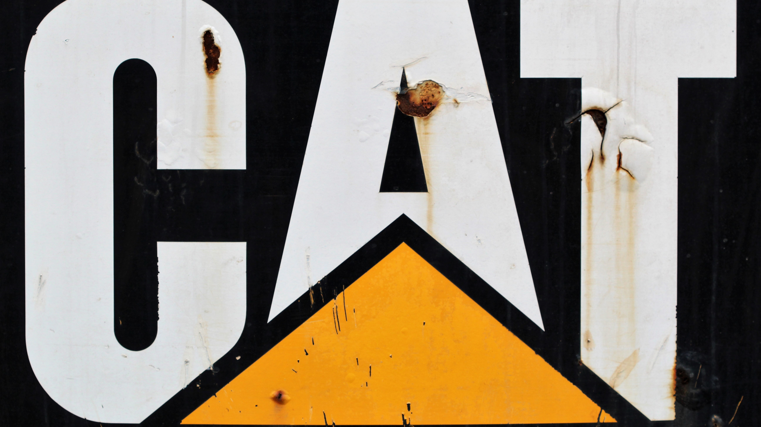
Demand Forecasting and Inventory Optimization for Caterpillar Inc.
Karan Joseph
Rohit Deshmukh
Syed Ahmed Milad
Trung Nguyen

Slide 2

Agenda
Introduction - Company and Problem Statement
Data Profile
Demand Forecasting
Forecast Results and Comparison
Inventory Management - Current Scenario
Inventory Management - Proposal (Scenario 2)
Comparative analysis/ Results
Conclusion

Slide 3

Introduction
Fortune 100 company
Industry player in mining, transportation, construction, infrastructure equipment
Focus: Excavators

Slide 4
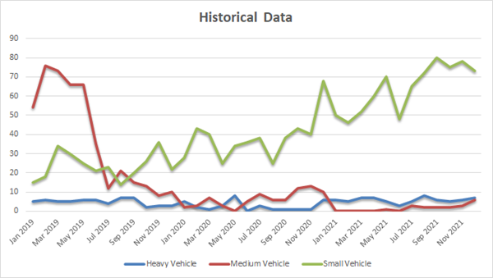
Data Profile
Monthly data over 3 years (36 months)
Constant demand for Heavy Vehicles
Exponential decline in sales for Medium Sized Vehicles
Steady growth for Small Vehicles

Slide 5
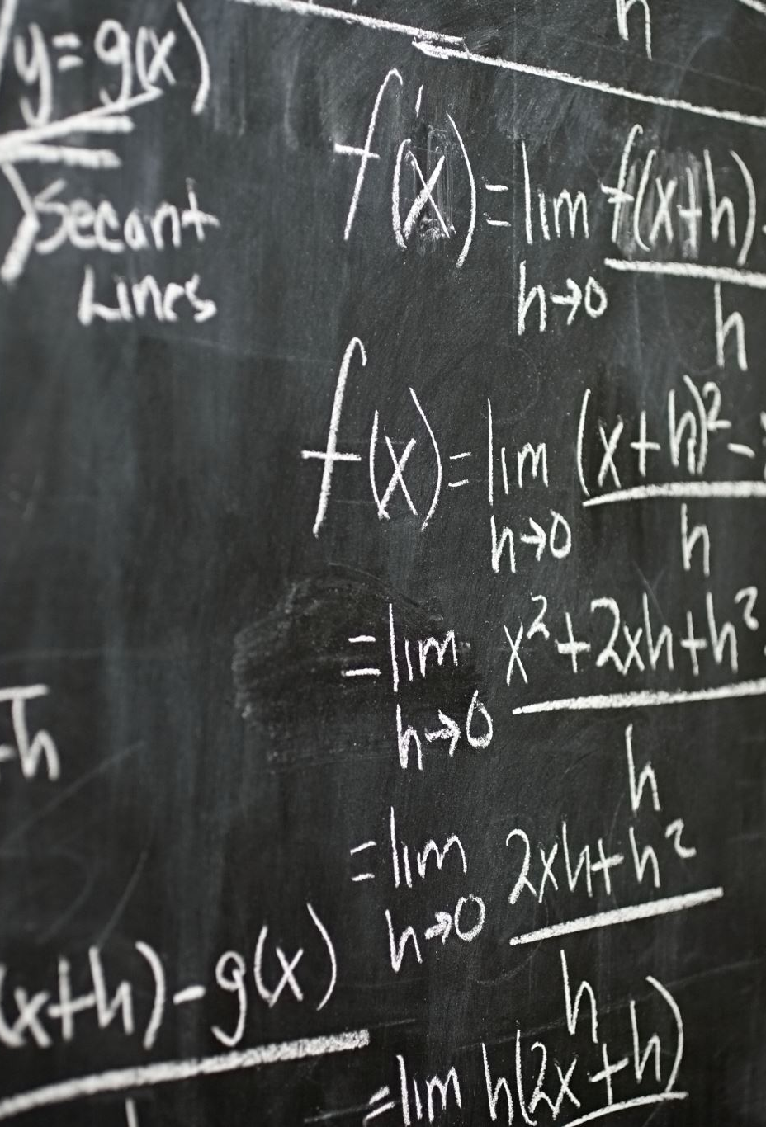
Demand Forecasting
Naïve Forecasting
Moving Average
Simple Exponential Smoothing
Multiple Exponential Smoothing (Holt)
Croston

Slide 6
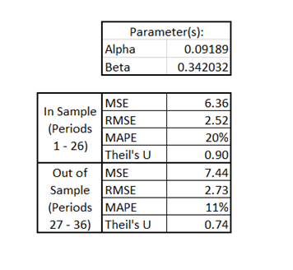
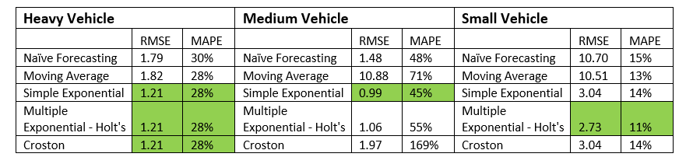
Forecast Results and Comparison

Slide 7
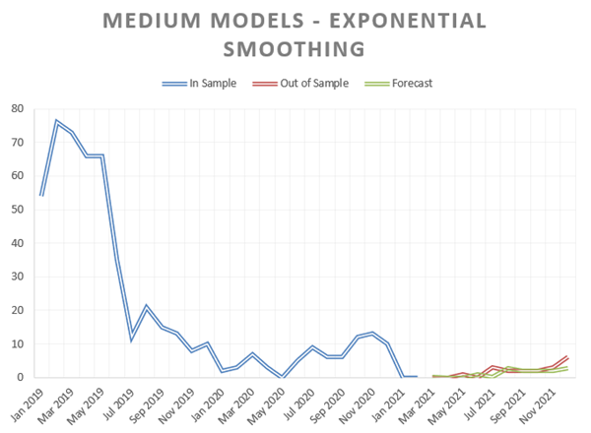
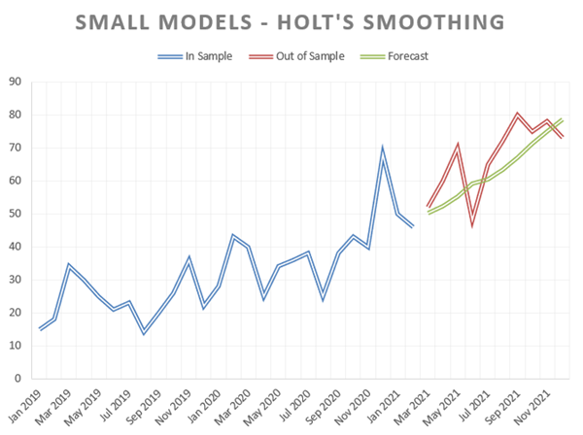
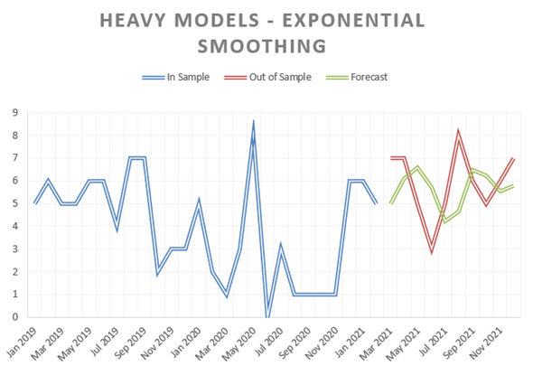

Slide 8
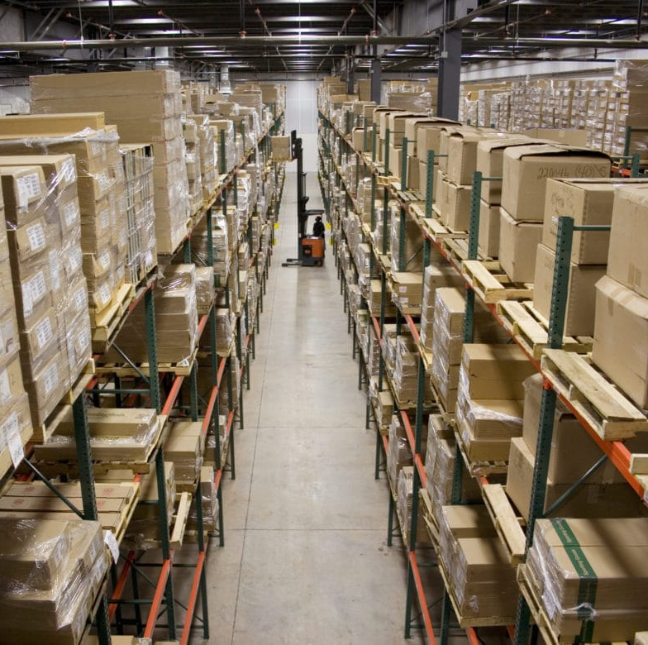
Inventory Management
Methodology
Current Scenario
No forecast
Inventory Management using R,S inventory policy
This Photo by Unknown author is licensed under CC BY.

Slide 9
Proposed Inventory Management Solution
Forecast demands using optimal techniques
Inventory Management using Silver Meal Heuristics
Safety Stock to account for forecasting errors

Slide 10
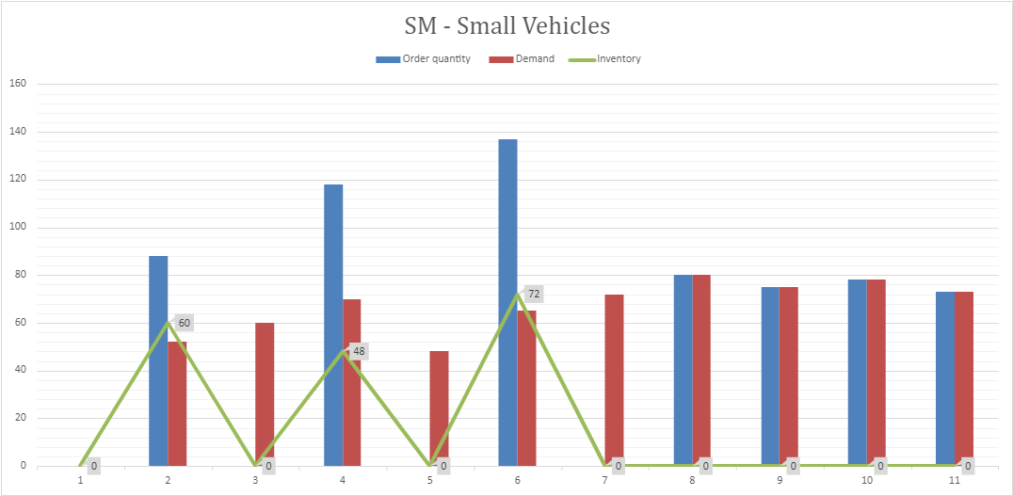
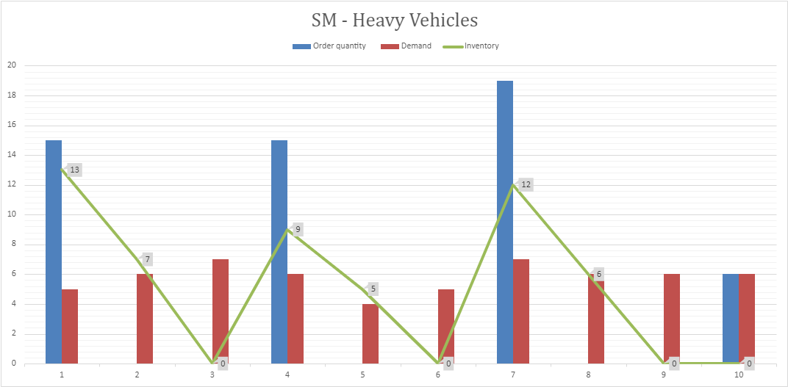
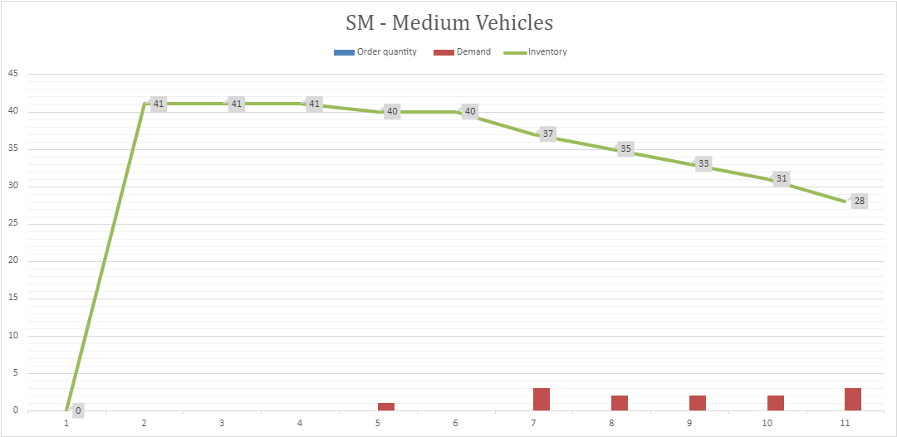

Slide 11
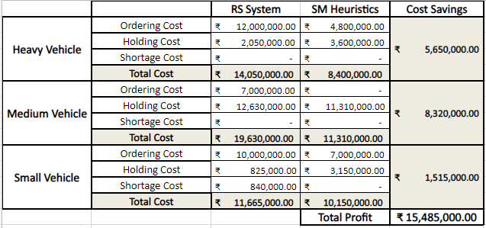
Comparative Analysis(Current Vs Recommendation)

Slide 12
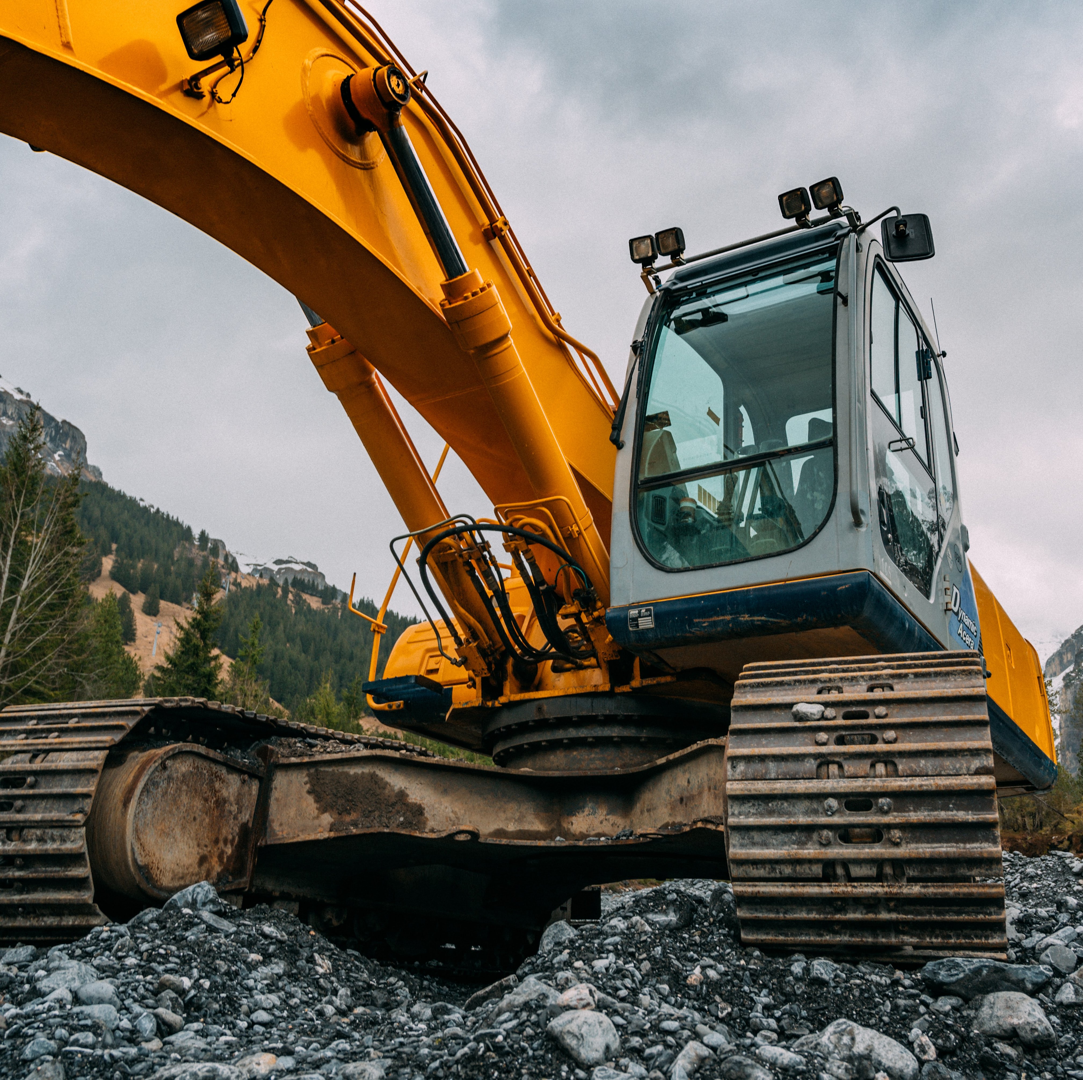
Conclusion
Best Demand Forecasting Models
Recommended solution
Business implications
Limitations
Assumptions
Unavailability of few important data parameters

Slide 13
Thank you
Any Questions

